Slide 1

jquery.js
system.js
buttons.css
index.js
moment.js
styles.css
FTP
index.html
list.html
Production
Server
categories.html

Slide 2
ADVANTAGES
DISADVANTAGES
Fast
Secure
Modules
Size
Versions
A lot of backups
Hard To Support big Project
God Files
Source Code Is not compressed

Slide 3


Slide 4
Manage local dependencies of project’s tools.
Manage globally-installed project’s tools.
Manage multiple versions of code and code dependencies.
Download standalone tools you can use right away.
NPM provides package-lock.json which displays all dependencies of the project.

Slide 5


Slide 6
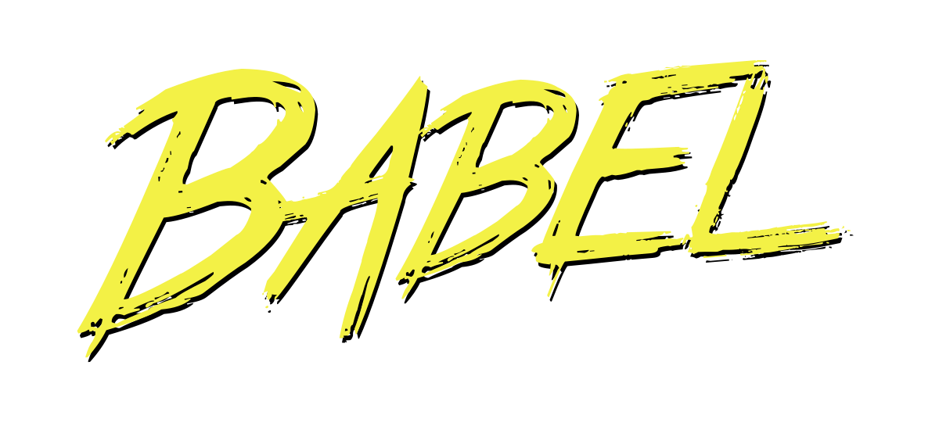

Slide 7
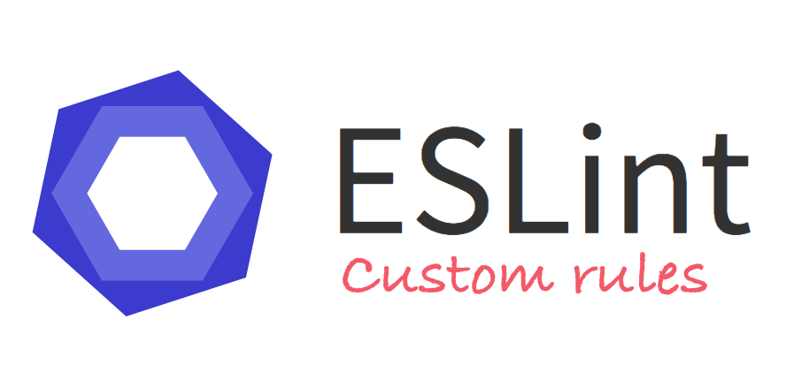

Slide 8
